Slide 1
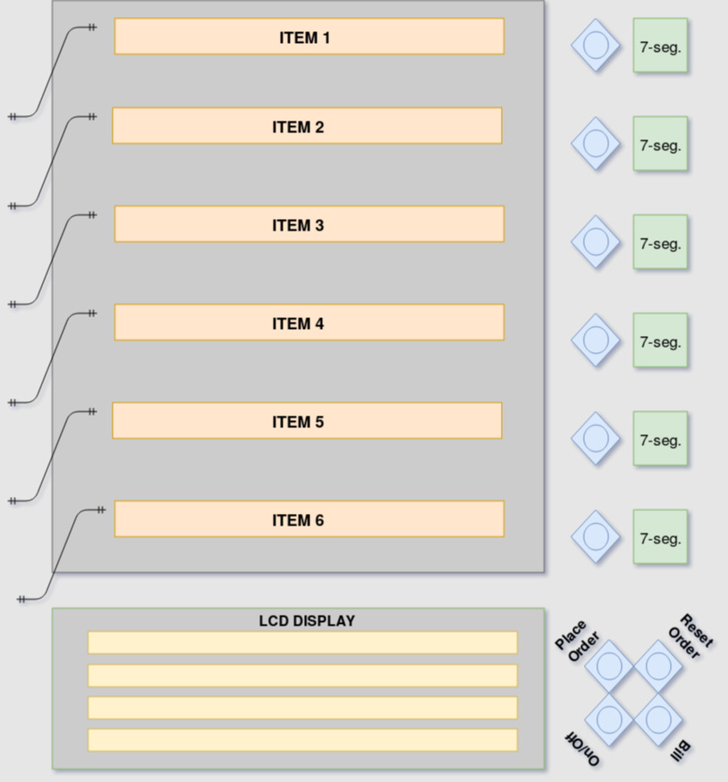
Wireless Ordering & Billing System for Restaurants
Under guidance of :
Prof. Subrat Kar
By :
Anshuman Singh
2018JTM2004

Slide 2
PROBLEM STATEMENT
Many times in hotel we have to wait for a waiter to give our order for food. This creates problem when there is rush in hotel especially in festival seasons and generally on weekends. Also, there are self-service hotels where customers have to get up each time to place and receive their orders. Customers also expect to have an idea about service time and total bill beforehand. Main intention of our project is to avoid such problems and to give a cost effective solution to such problems.

Slide 3
PROPOSED SOLUTION / SPECIFICATIONS
A low cost, simple and intuitive paper based menu card with Wi-Fi connectivity modular in terms of menu card attached which can be changed or updated.
Client-Server model where the customer sitting at a table is the client and the chef/employees/reception of the restaurant will act as server.
User inputs through buttons placed next to menu items listed.
7-segments to display selections made along with LCD to display detailed status about ordering & billing.
Wireless connectivity with the Server.

Slide 4
COMPONENTS USED
ESP32 as micro-controller
LCD 20*4
7-segment LEDs
LDRs (Light Dependent Resistors)
Menu Card in a proper specified format
Others (resistors, wires, pcb board etc.)

Slide 5
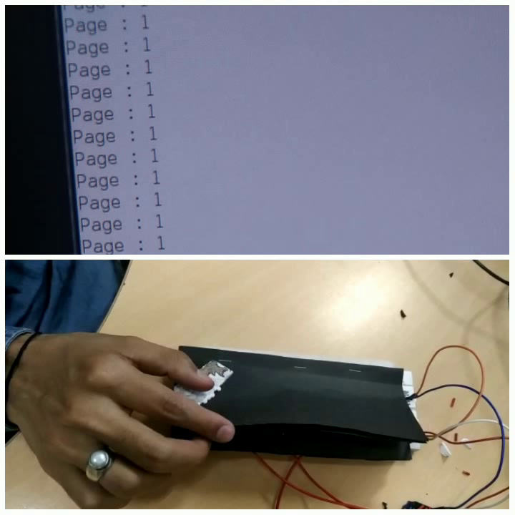
PROJECT DESIGN
The project implementation can be divided into the following broad categories:
Determining Page Number:
As the menu items are distributed over a few pages and only limited buttons are available to the user, a mechanism based on LDR’s to determine the page number is proposed.
One LDR is always exposed to light and determines the current lightening conditions.
Three other LDR’s are embedded in the menu and a different set of LDR gets exposed as pages are turned.
Readings of all these LDR are then compared with the reference LDR to find the page number.

Slide 6
PROJECT DESIGN
Getting user input from buttons:
There are limited number of GPIO’s in ESP32. However a minimum of 10 user inputs for different options needs to be taken.
The buttons are connected with a voltage divider circuit with the help of resistors. When a button is pressed the potential drop changes and this is read through the analog pins of ESP32.
A total of 4 buttons have been connected to a single analog pin with a good margin to avoid any error.
Only 3 analog pins have used to get inputs from all the buttons.

Slide 7
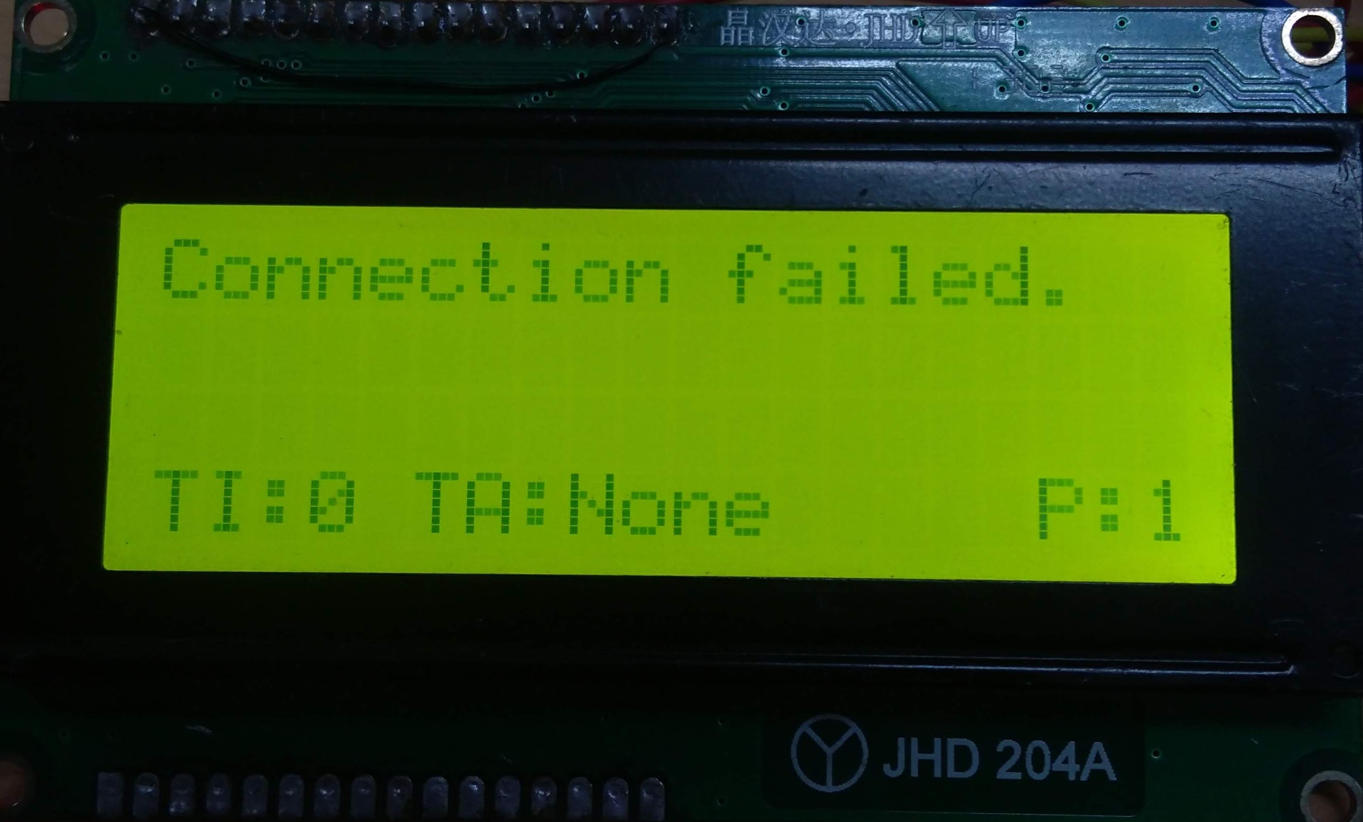
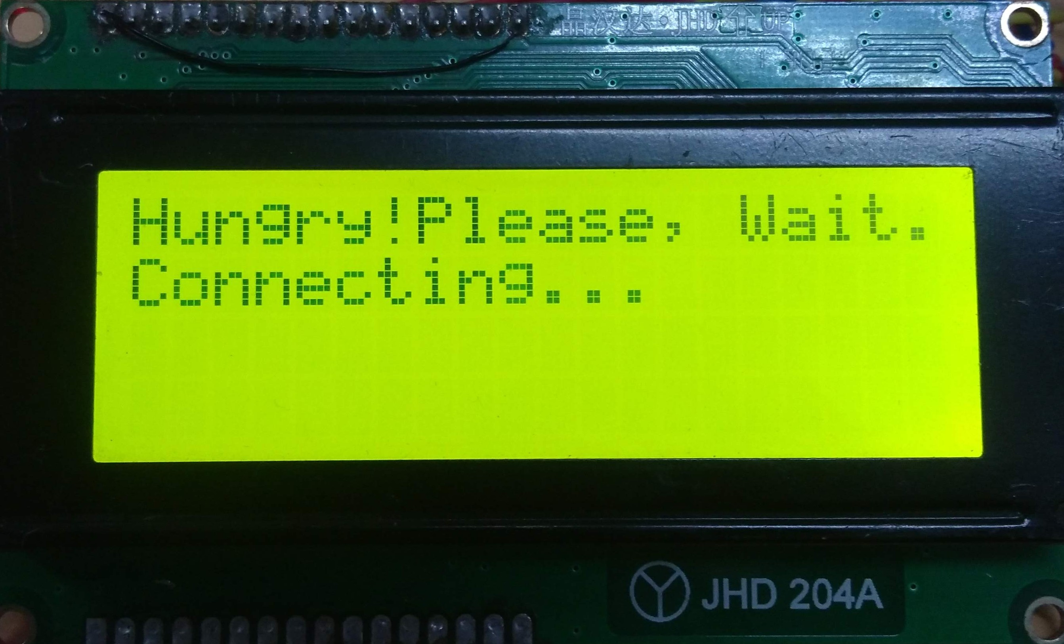
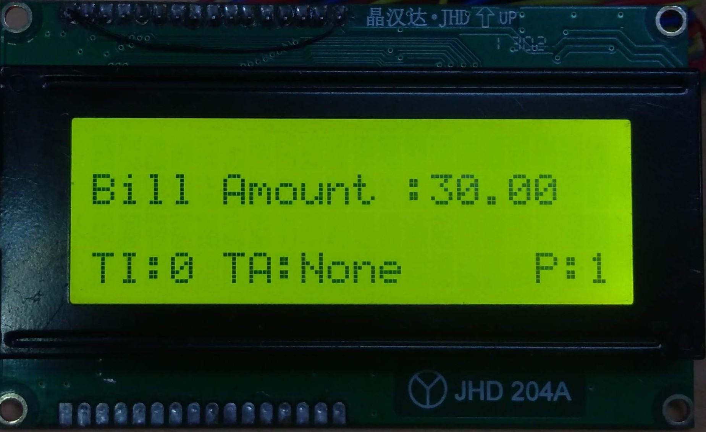
PROJECT DESIGN
Displaying User Input and Server Response :
To make the interface available to the user more intuitive, a 7 segment display has been placed next to each button which displays the number of items ordered for that menu item.
As the page is turned this display gets updated to show the selections made in that page.
Also, a 20*4 LCD has been placed at the bottom of the menu to display the selections made and response from the server.

Slide 8
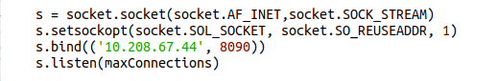
PROJECT DESIGN
Connecting with Server :
Server in this project is a Python Socket server running on a computer and client is the ESP32 placed on the menu card.
Server uses a socket connection to communicate with the ESP32 using TCP protocol.
For every selection made a request is sent to the server and the response received is shown on the LCD’s 1st row.

Slide 9
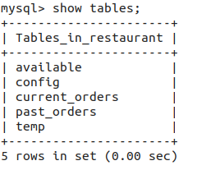
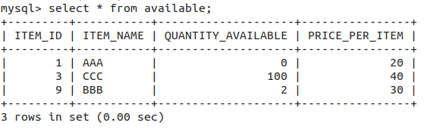
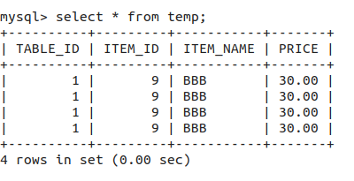
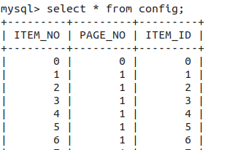
PROJECT DESIGN
Storing Data and Configuration:
To store the data about available items, past orders, current orders and configuration files MySQL database server has been used.
To keep records a total of 5 tables in SQL have been used.
available : available quantiy
config : configuration file
temp : to store selections
current_orders : store current placed orders
past_orders : store past orders record

Slide 10
BILL OF MATERIALS USED
ITEM NAME | QUANTITY | PRICE (Rs.)
ESP32 | 1 | 480
LCD 20*4 | 1 | 400
7-segment LEDs | 6 | 54
LDRs | 4 | 32
Others | - | 50
Total | - | 1016

Slide 11
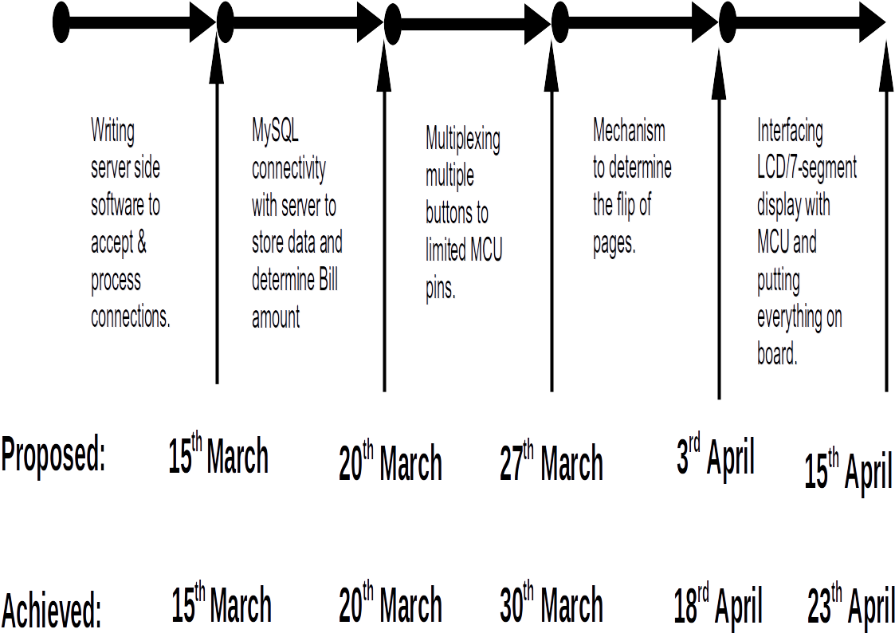
PROJECT TIMELINE / MILESTONES

Slide 12
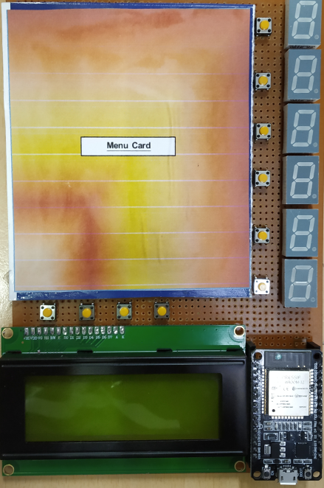
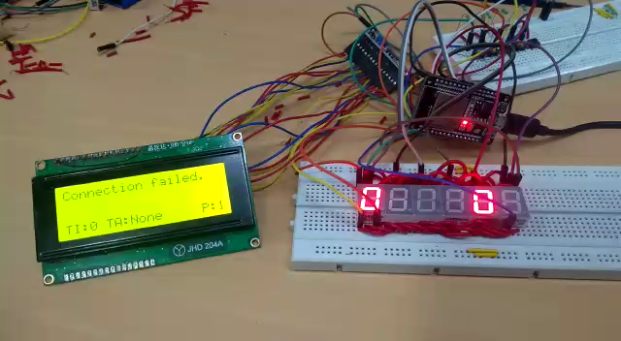
RESULTS

Slide 13
DIFFICULTIES FACED
Server unware of whether client connection terminated abruptly.
Interfacing 7-segments
To display all the 6 LEDs simultaneously persistence of vision has been used. This works well if the LEDs are updated withing 10ms. Such a change will not visible. However, the main loop delay in the project is higher than this giving blinking effect to LEDs.

Slide 14
CONCLUSION
The project works well to address the problem mentioned at the begining.
The use of configuration files make it easy to change the menu items anytime as per different restaurant.
The user-interface is intuitive and closely resembles traditional menu cards.
The project avoids the hassle of getting up every now and them to place an order and review its status.
Due to its ultra low cost and full functionality it can easily be adopted by restaurants as their default method for placing orders.

Slide 15
REFERENCES
ESP32 Pinout Reference
MySQL Documentation
LDRs Reference
7-segment LEDs
LCD 20*4

Slide 16
THANK YOU

